Slide 1
FLOYD’S ALGORITHM
Abdelrahman Khaled
Omar Bahaa
MennaTullah Abdelrahman

Slide 2
TABLE OF CONTENTS
01
02
03
04
ALL PAIRS SHORTEST PATH PROBLEM
Floyd’s algorithm
PARALLEL FORMULATION
ANALYSIS

Slide 3
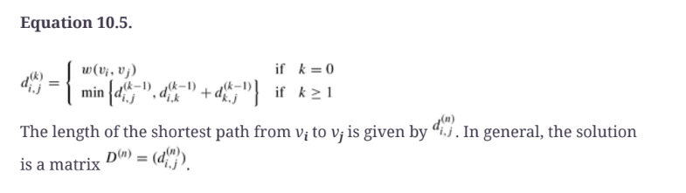
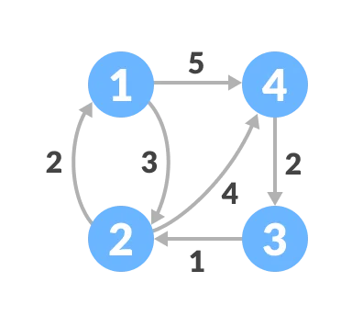
PROBLEM: All Pairs Shortest Path

Slide 4
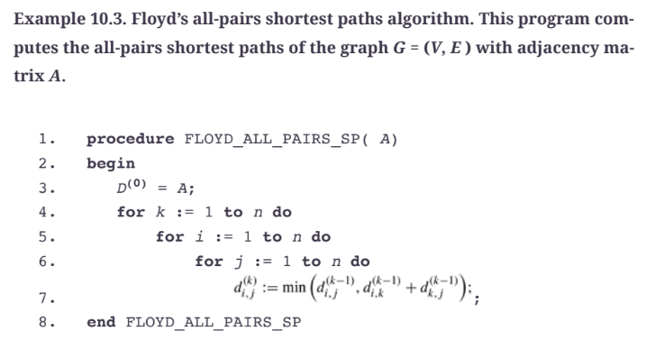
2. Floyd’s Algorithm: DEMO

Slide 5
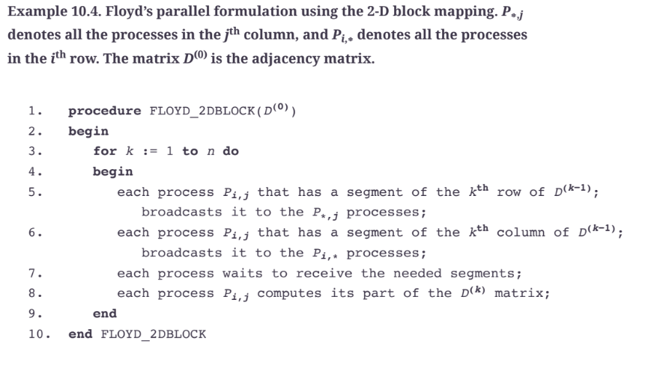
3. Parallel Formulation: 2D Block Mapping / DEMO

Slide 6
4. Analysis
Applying on the first Matrix
Time of Serial
Time after Blocking
Speedup
Efficiency

Slide 7
THANKS!

Slide 8
References
https://www.programiz.com/dsa/floyd-warshall-algorithm
Introduction to Parallel Programming

